Slide 1
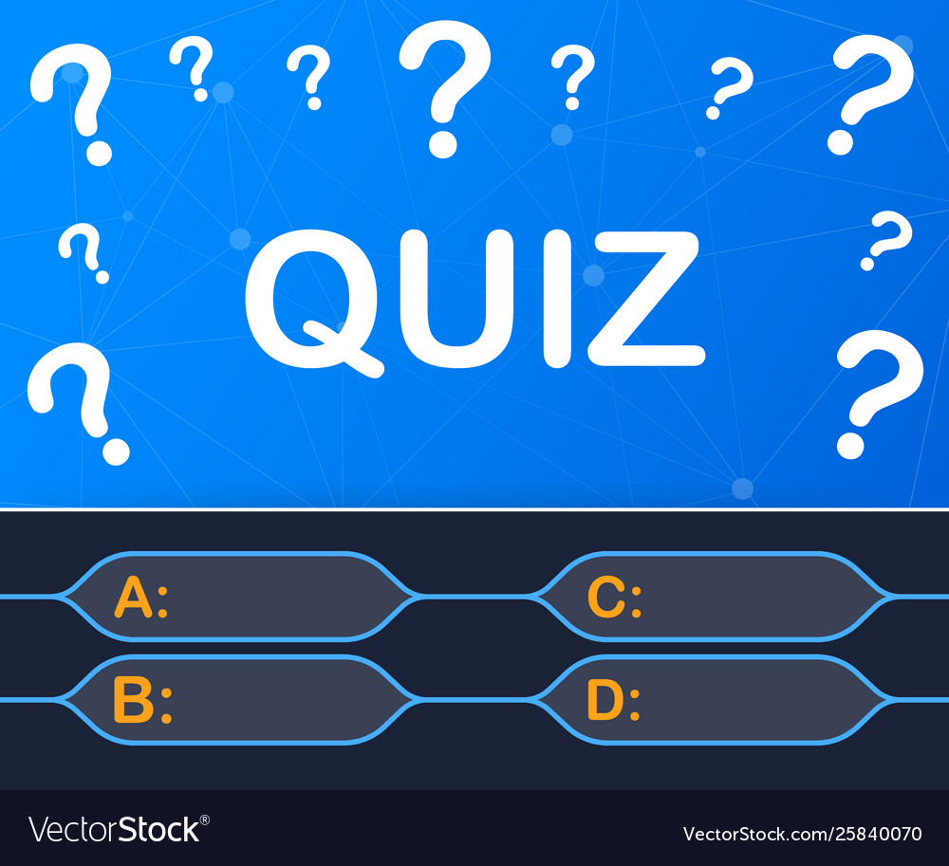
Mini Project-1 Quiz game
Talveda Shreya reddy 1602-20-737-041
Ramagalla anish 1602-20-737-005
Tuppari Vishnu Vardhan reddy 1602-20-737-060

Slide 2
Abstract:
The Quiz App In Python is a simple project for taking and giving the examination online. The project contains questions and options. users can directly enter the quiz program.
Moreover, the project file contains python scripts (quiz.py) and JSON files. In addition, about the features of the Online Quiz system, user can log in to give the exam. The design of this project is pretty simple so that the user won’t find any difficulties while working on it.

Slide 3
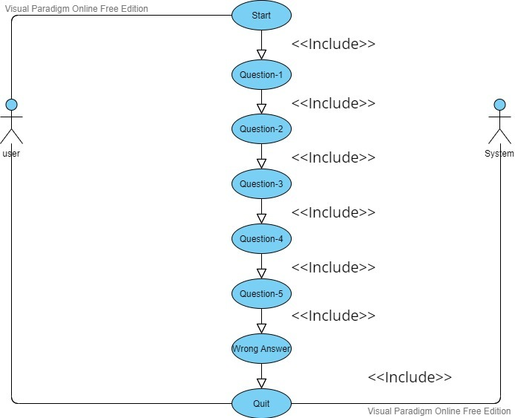
USE CASE DIAGRAM

Slide 4
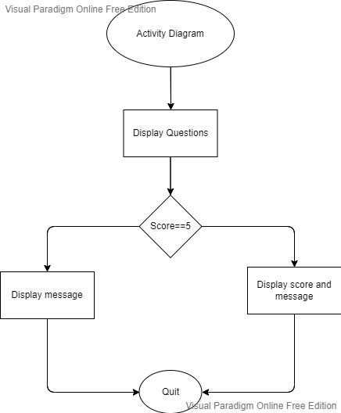
ACTIVITY DIAGRAM
.

Slide 5
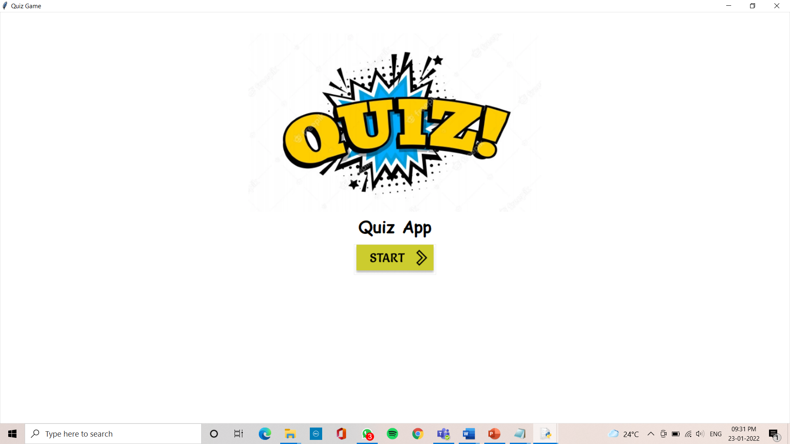
SCREENSHOTS OF EXECUTION

Slide 6
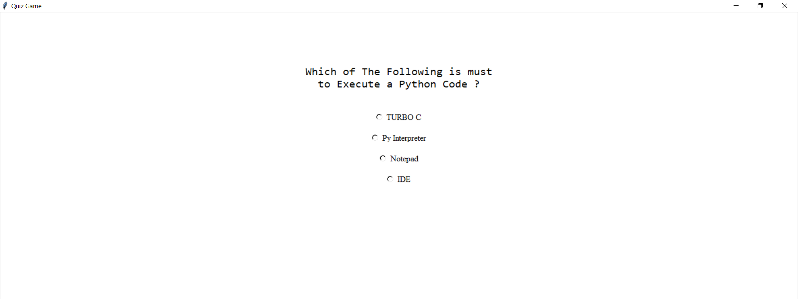

Slide 7
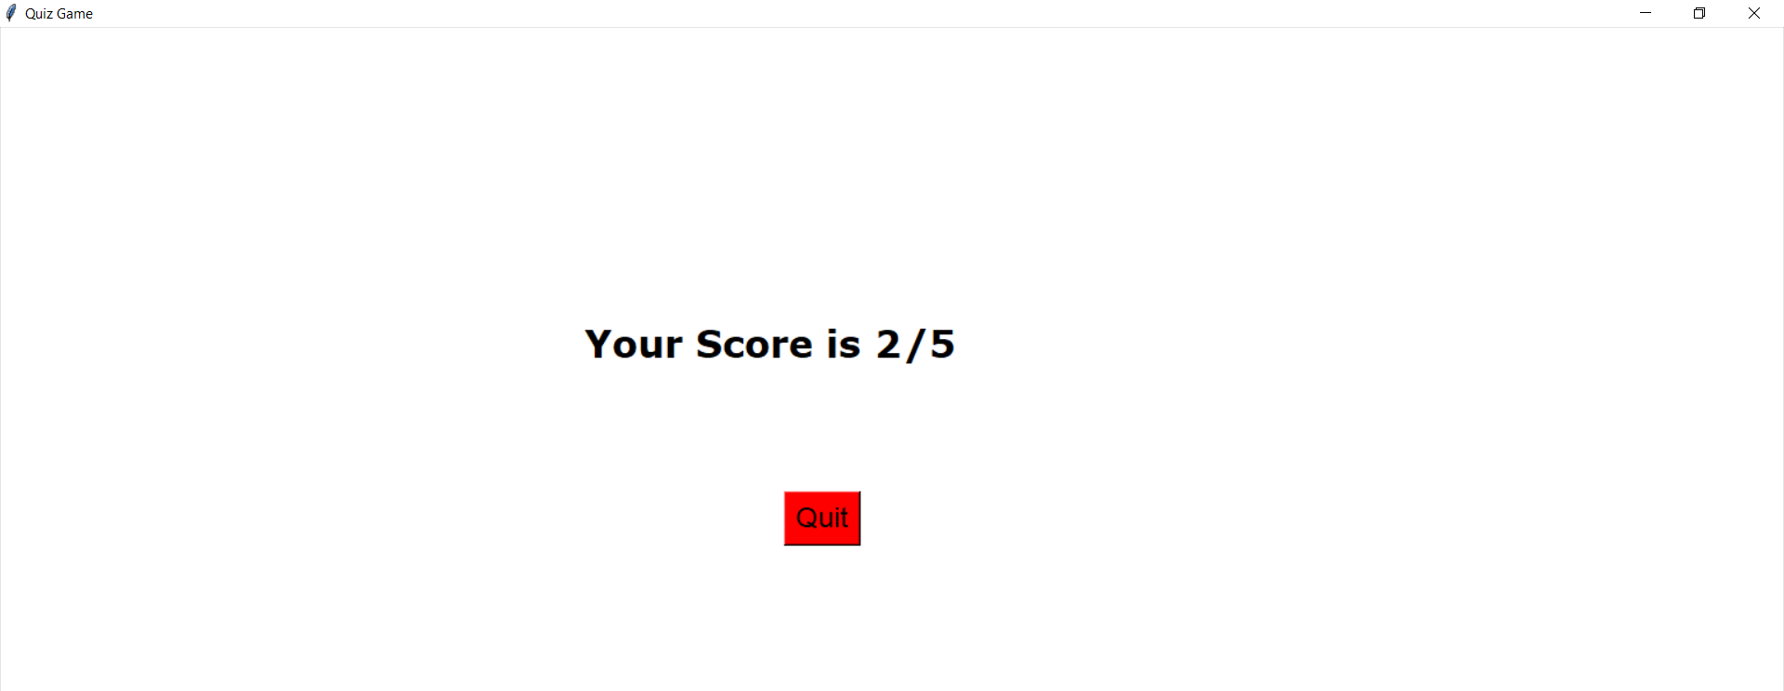

Slide 8
CONCLUSION
Assess knowledge quizzes are meant to track, report and evaluate learning progress and outcomes. Online quizzes are easier, motivates learners, engage learners, improvesknowledge retention and transfer.

Slide 9
Thank you

